Slide 1

Stock Data Assistant
An interface assistant that focuses on "real-time stock data" and "related peripheral services."

Slide 2

Description
A real-time stock data assistant, combined with related peripheral services, can provide valuable information and tools for investors, traders, and anyone interested in the stock market.
By offering real-time stock data along with comprehensive market information and tools, this assistant aims to empower users to make informed investment decisions and stay updated on market developments. It caters to both novice investors seeking educational resources and experienced traders looking for advanced analytics and trading capabilities.

Slide 3
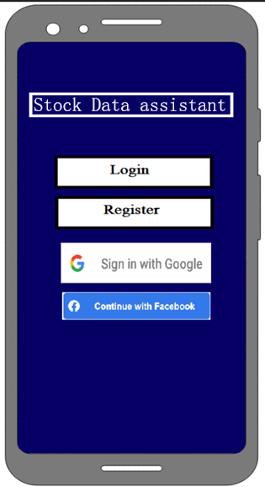
This marks the initial screen of our application. Here, you'll be presented with options to either log in or create an account to unlock additional features. You can choose to sign in using your Google or Facebook account or opt for email authentication.
First Screen

Slide 4
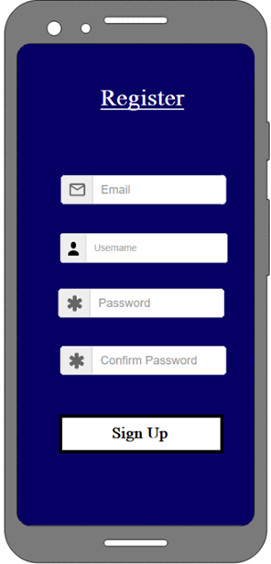
Registration Screen
Welcome to our registration screen. Here, you'll be guided to provide your email, a username, and a password. Rest assured, this data will be securely stored in our Firebase database for future reference.

Slide 5
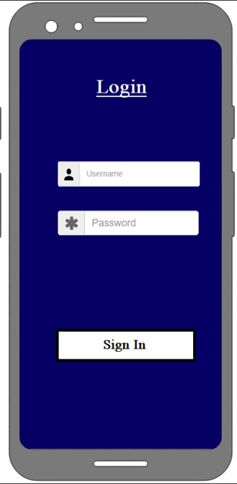
Login Screen
This is our login screen. It will ask you to input both your username and password in order to access your account.

Slide 6
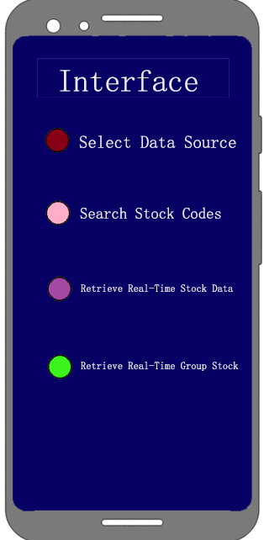
Main Screen
Select Data Source
Search Stock Codes
Retrieve Real-Time Stock Data
Retrieve Real-Time Group Stock Data

Slide 7
Because the data rules for each exchange vary, a rule has been defined to standardize code definitions: "Exchange + Stock Code."
The problem
Exchange | Code | Example
Shanghai Stock Exchange | SH | SH000001
Shenzhen Stock Exchange | SZ | SZ399001
Hong Kong Stock Exchange | HK | HKHSI
U.S. Stock Exchange | US | USDJI

Slide 8

Data Sources
import { stocks } from "stock-api";
// Data Sources
const sina = stocks.sina;
const xueqiu = stocks.xueqiu;
const netease = stocks.netease;
const tencent = stocks.tencent;

Slide 9

Search Stock Codes
import { stocks } from "stock-api";
// Get real-time data for a group of stocks
stocks.sina.searchStocks(["510500"]).then(console.log);

Slide 10

Output
[{
code: 'SH510500',
name: '500 ETF',
percent: 0.028383,
now: 7.174,
low: 6.93,
high: 7.184,
yesterday: 6.976
}]

Slide 11

Task Management App
Created a task management web application using React.js.
Implemented user authentication, task creation, and task tracking features.
Utilized Firebase for backend services.
GitHub Repository: https://github.com/baisiyou
Team Manager
Rubing Zhang
Programming Languages: Java, JavaScript
Web Technologies: HTML, CSS
Front-End Frameworks: React, Angular
Version Control: Git/GitHub
Problem-Solving and Debugging
Responsive Web Design
Cross-Browser Compatibility
Web Performance Optimization

